Slide 1

CATCH them all
BEST SEARCH RESULTS? Don't worry, we FIND it FOR YOU!

Slide 2
Idea
Sharing knowledge between experts, professors, students
Lead a professional debate under the articles from experts and professors
Make tool for finding expert in specific topic who can helps students or give advice professors
Make a tool for students to find jobs based on their skills

Slide 3

HOW TO BE DIFFERENT?
Search job engine, which calculate with your skills, and your recent interest
Find experts based on technology what you need

Slide 4
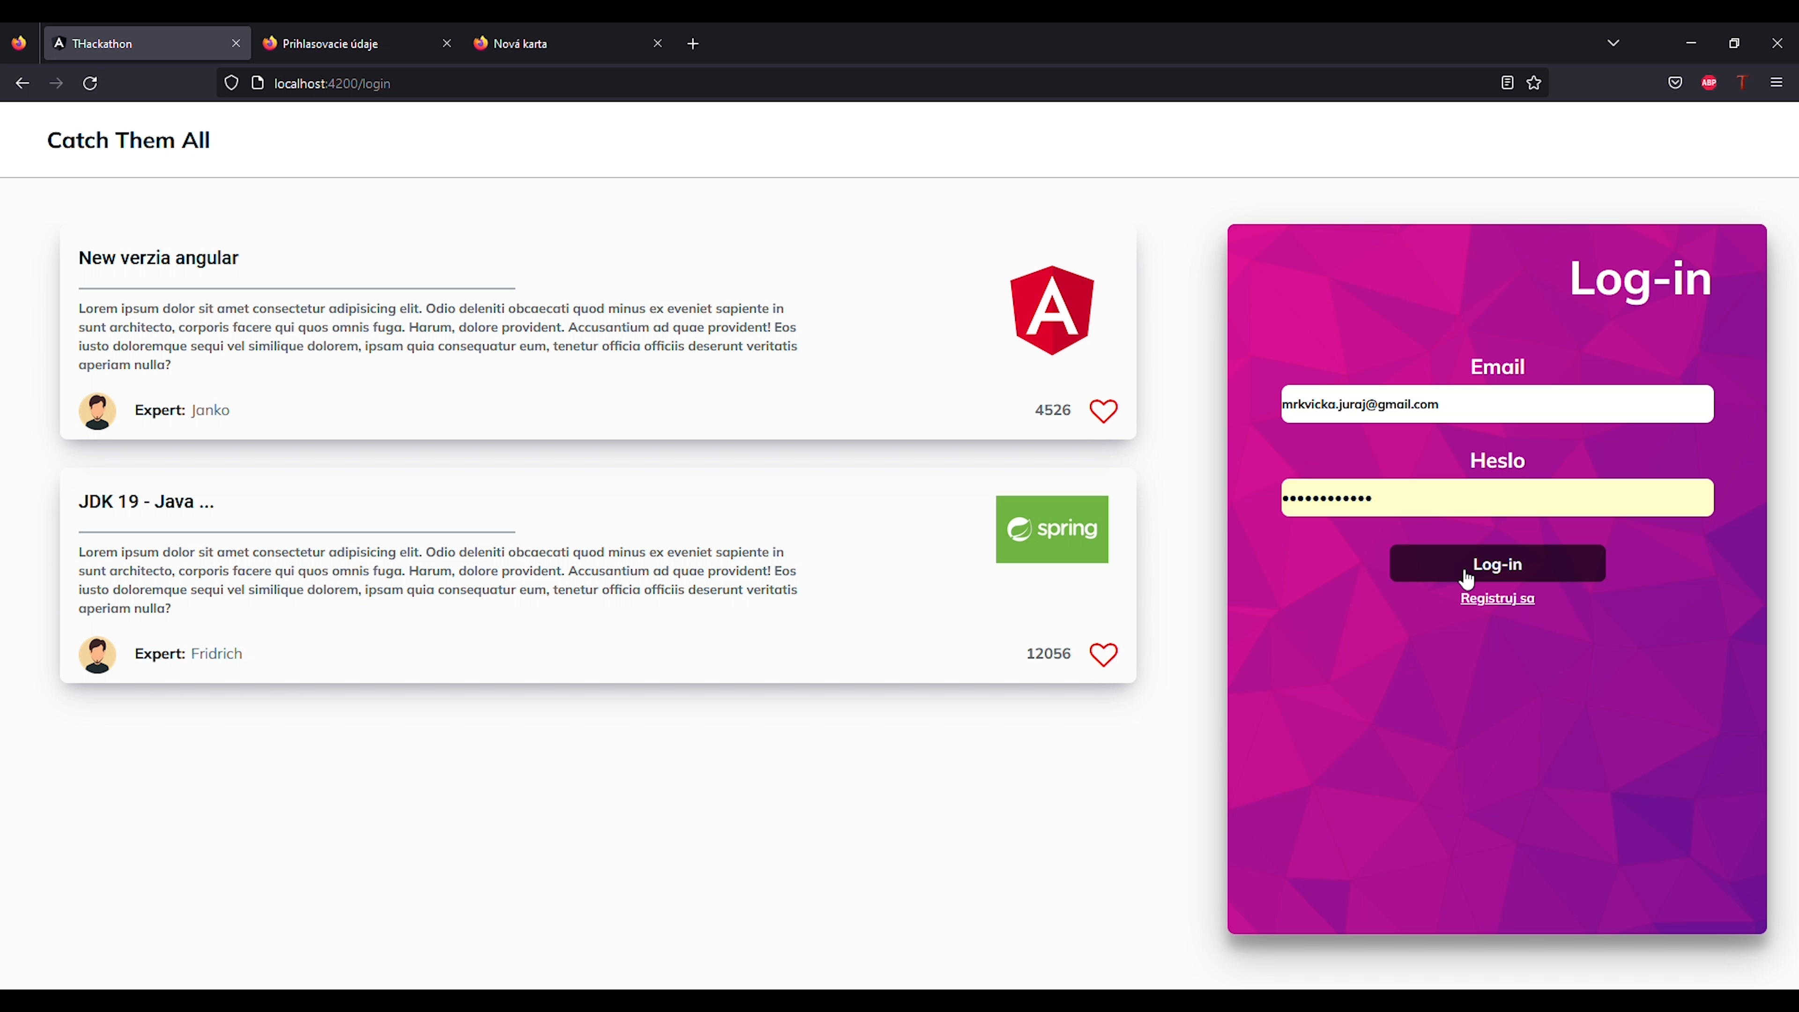

Slide 5
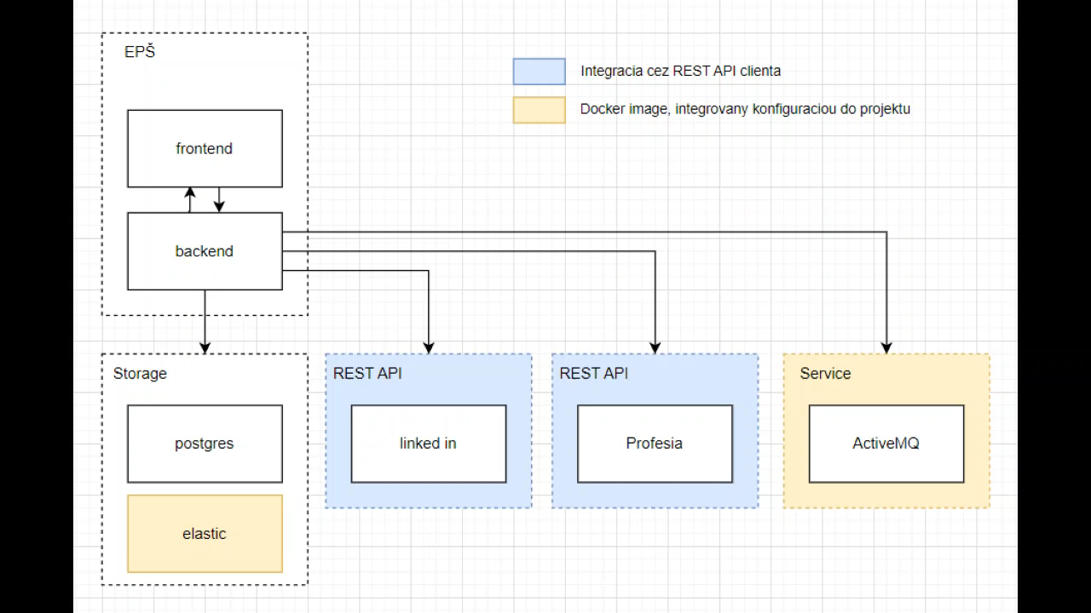
Creation Process

Slide 6








TechnOlogies WE USE

Slide 7


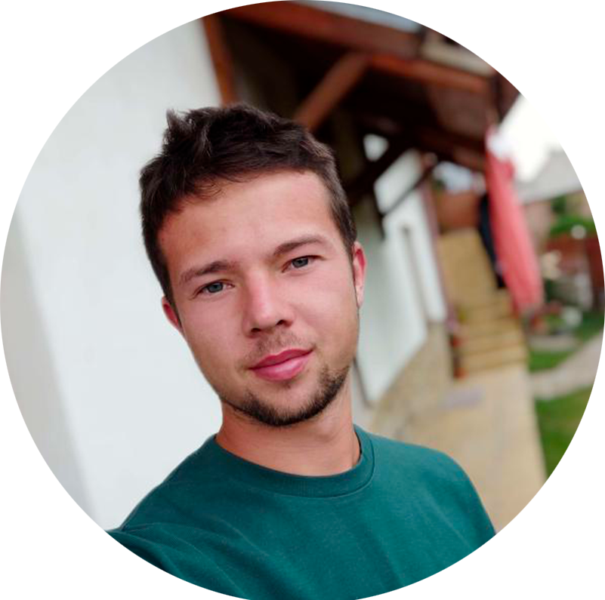
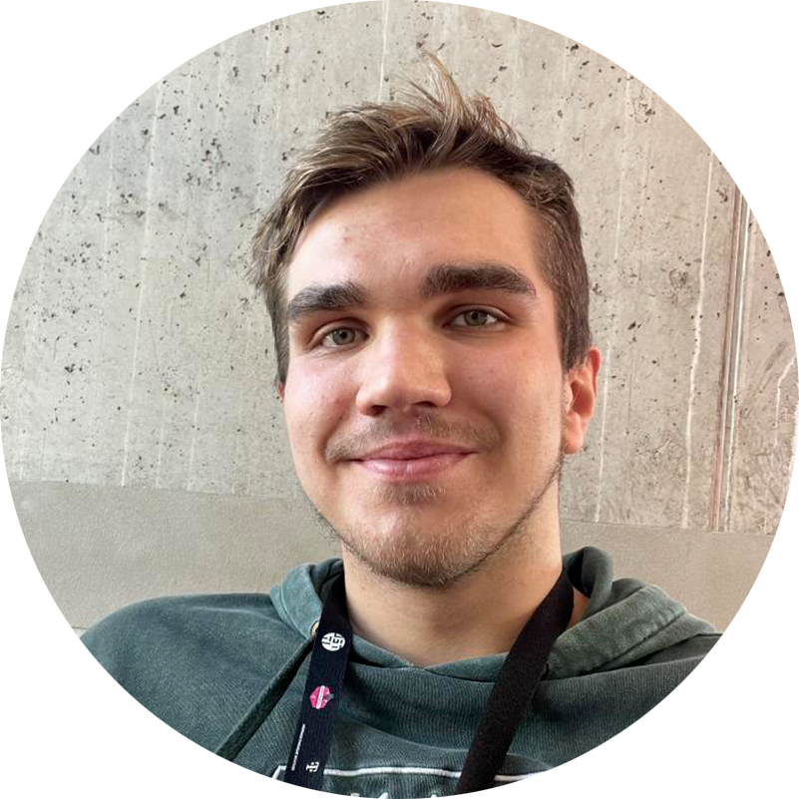

OUR TEAM
MICHAL POPOVIČ
MARTIN MOCHNACKÝ
frontend
IGOR LENGEL
frontend
backend
Linked
https://www.linkedin.com/in/igorlengel/
https://www.linkedin.com/in/michal-popovi%C4%8627a28238/
https://www.linkedin.com/in/martin-mochnacky-b152b7256/
„Images by (vectorjuice, pikisuperstar, upklyak) / Freepik"

